Slide 1
Mathematics
Dr Ali Amin Abduljabar

Slide 2
Syllabus
Numerical Analysis
1- Solution of Nonlinear Equations
2- Solution of Ordinary Differential Equations
3- Solution of Partial Differential Equations
4- Numerical Optimization
Linear Algebra
First few chapters on Linear Algebra references

Slide 3
Refrences
Numerical analysis,7th edition
By Richard L. Burden
Matrix Analysis and Applied Linear Algebra
By Carl D. Meyer

Slide 4
Chapter one Solution of Nonlinear Equations
If a continuous function f(x) has values of opposite signs at the end points of an interval [a,b] (i.e. f(a).f(b)<0), then this interval must contain at least one root of the equation f(x)=0. this root will be the only root if the derivative f´(x) exists and preserves sign within the interval [a,b] that is if f´(x)<0 or f´(x)>0 for [a<x<b]

Slide 5
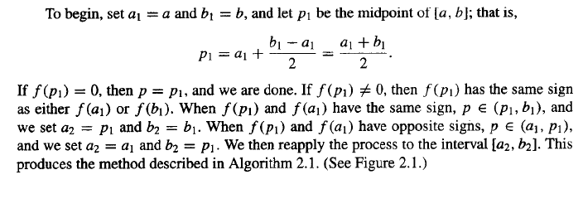
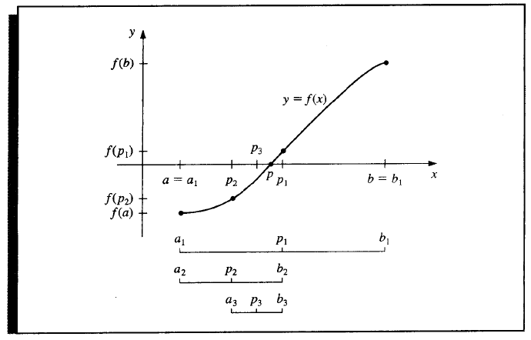
Bisection Method

Slide 6
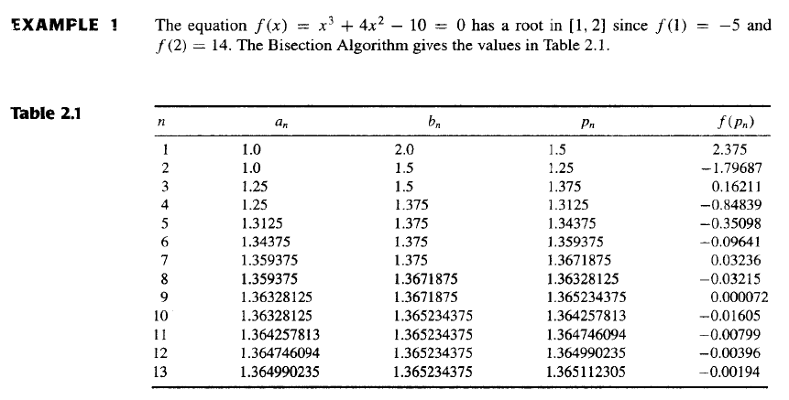

Slide 8
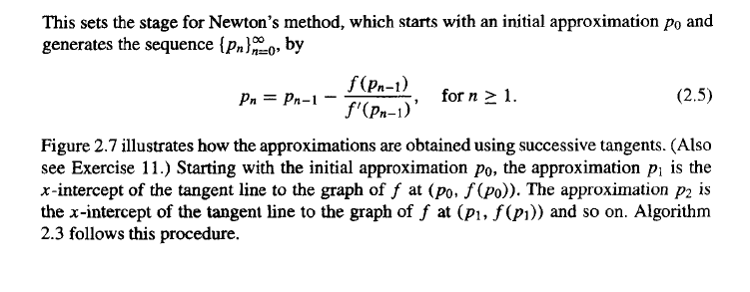
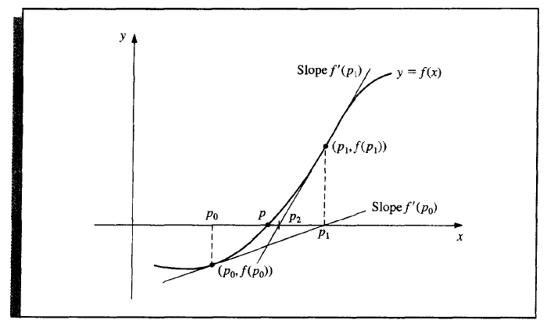

Slide 9
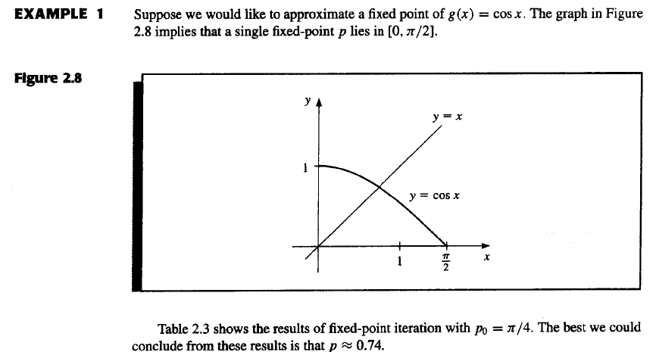

Slide 10
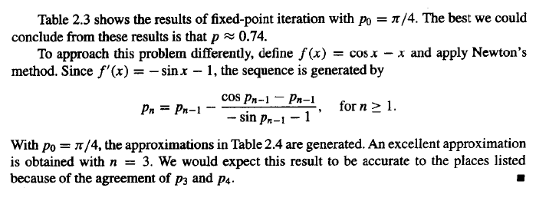
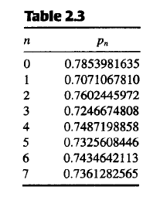

Slide 11
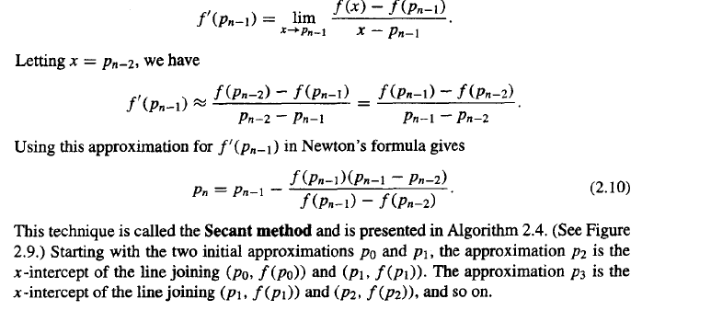
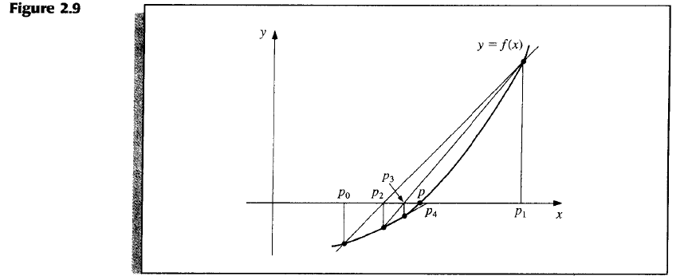

Slide 12
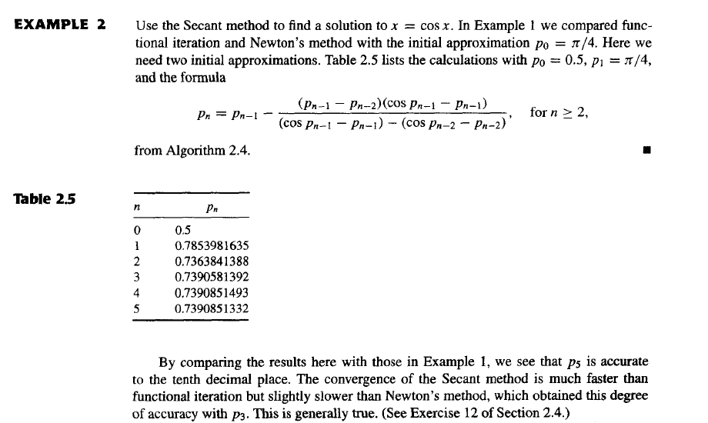

Slide 13
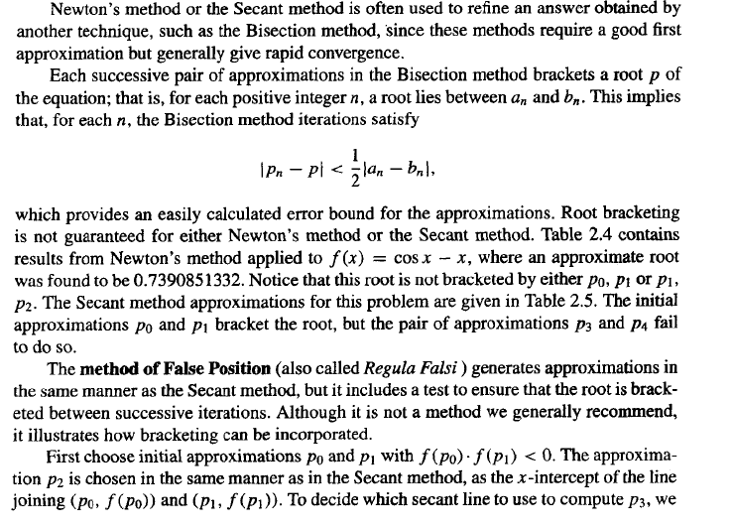

Slide 14
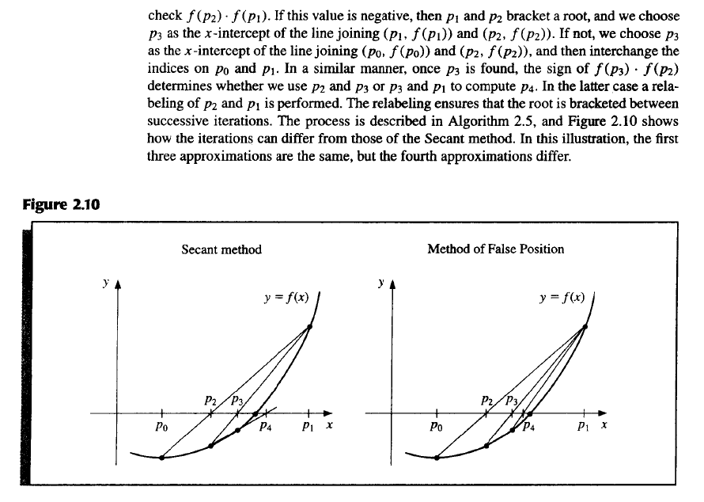

Slide 15
